Slide 1
Removing Autocorrelation and Multicollinearity

Slide 2
The Current Population Survey (CPS) is used to supplement census information between census years. These data consist of a random sample of 534 persons from the CPS, with information on wages and other characteristics of the workers, including sex, number of years of education, years of work experience, occupational status, region of residence and union membership.
We wish to determine (i) whether wages are related to these characteristics and (ii) whether there is a gender gap in wages. Based on residual plots, wages were log-transformed to stabilize the variance. Age and work experience were almost perfectly correlated (r=.98). Multiple regression of log wages against sex, age, years of education, work experience, union membership, southern residence, and occupational status showed that these covariates were related to
wages (pooled F test, p < .0001).
The effect of age was not significant after controlling for experience. Standardized residual plots showed no patterns, except for one large outlier with lower wages than expected. This was a male, with 22 years of experience and 12 years of education, in a management position, who lived in the north and was not a union member. Removing this person from the analysis did not substantially change the results, so that the final model included the entire sample.
Adjusting for all other variables in the model, females earned 81% (75%, 88%) the wages of males (p < .0001). Wages increased 41% (28%, 56%) for every 5 additional years of education (p < .0001). They increased by 11% (7%, 14%) for every additional 10 years of experience (p < .0001). Union members were paid 23% (12%, 36%) more than non-union members (p < .0001).
Northerns were paid 11% (2%, 20%) more than southerns (p =.016). Management and professional positions were paid most, and service and clerical positions were paid least (pooled F-test, p < .0001). Overall variance explained was R2 = .35. In summary, many factors describe the variations in wages: occupational status, years of experience, years of education, sex, union membership and region of residence.
However, despite adjustment for all factors that were available, there still appeared to be a gender gap in wages. There is no readily available explanation for this gender gap.

Slide 3
Data Description
The datafile (wagesmicrodata.xls) is downloaded from http://lib.stat.cmu.edu/datasets/.
It contains 534 observations on 11 variables sampled from the Current Population Survey of 1985.
The Current Population Survey (CPS) is used to supplement census information between census years. These data consist of a random sample of 534 persons from the CPS, with information on wages and other characteristics of the workers, including sex, number of years of education, years of work experience, occupational status, region of residence and union membership. We wish to determine whether wages are related to these characteristics.

Slide 4
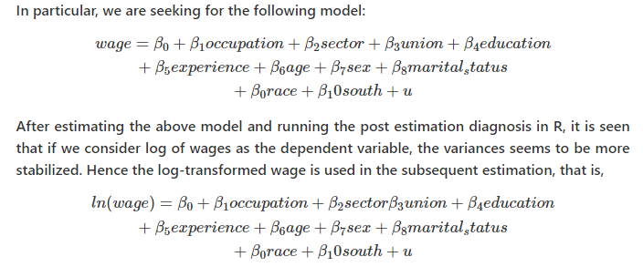
Data Description

Slide 5
Data Analysis in R
> library(dplyr)
> wagesmicrodata <-read.csv("C:/Users/Dell/Desktop/2021-22-First Sem/multicol.csv")
> fit1<- lm(log(WAGE)~OCCUPATION+SECTOR+UNION+EDUCATION+EXPERIENCE+AGE+SEX+MARR+RACE+SOUTH, data=wagesmicrodata)
> summary(fit1)

Slide 6
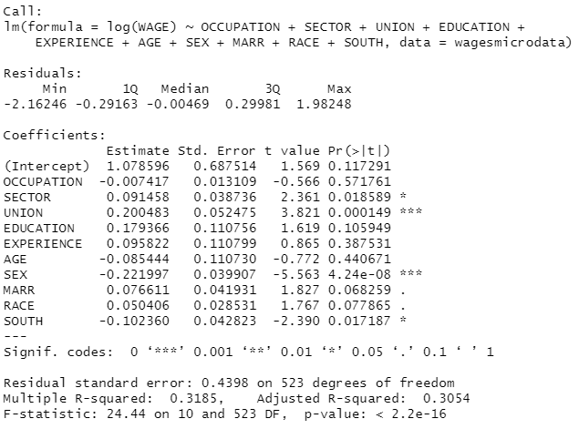
Data Analysis in R

Slide 7
By looking at the model summary, the R-squared value of 0.31 is not bad for a cross sectional data of 534 observations.
The F-value is highly significant implying that all the explanatory variables together significantly explain the log of wages.
However, coming to the individual regression coefficients, it is seen that as many as four variables (occupation, education, experience, age) are not statistically significant and two (marital status and south) are significant only at 10 % level of significance.
Further we can plot the model diagnostic checking for other problems such as normality of error term, heteroscedasticity etc.

Slide 8
Diagnostic Checking
> par(mfrow=c(2,2))
> plot(fit1)

Slide 9
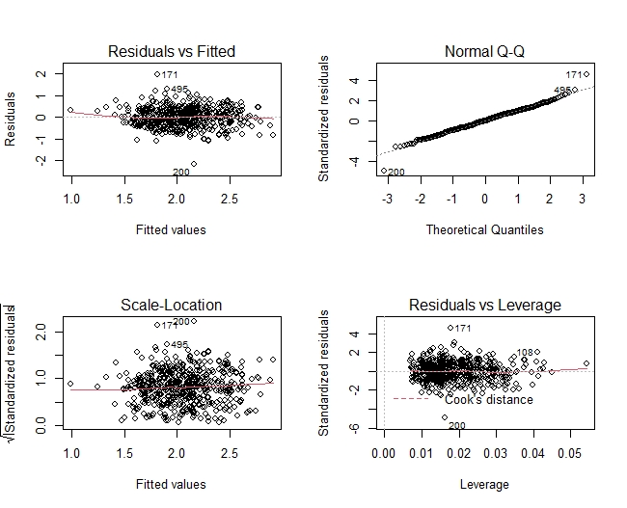
Diagnostic Checking

Slide 10
Diagnostic Checking
Thus, the diagnostic plot is also look fair.
So, possibly the multicollinearity problem is the reason for not getting many insignificant regression coefficients.
For further diagnosis of the problem, let us first look at the pair-wise correlation among the explanatory variables.
> library(GGally)
> X<-wagesmicrodata[,2:11]
> ggpairs(X)

Slide 11
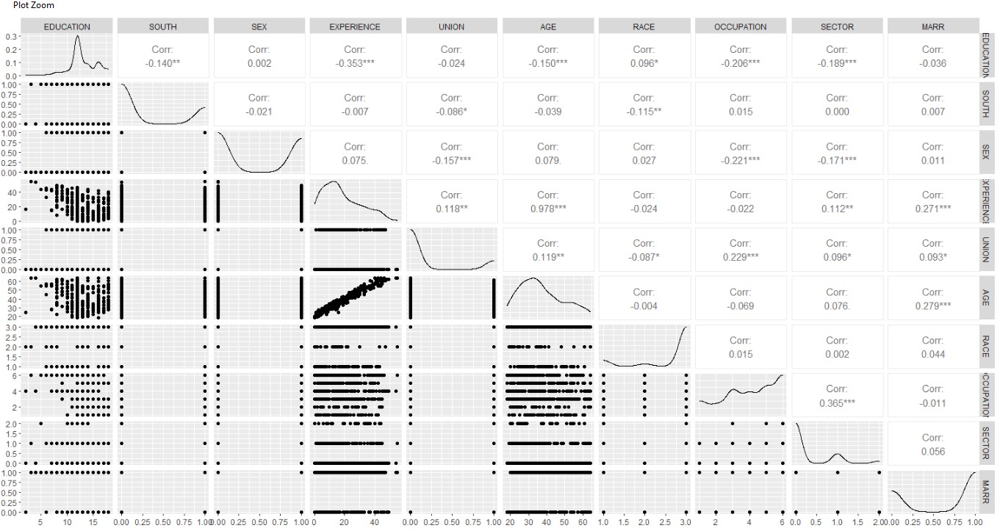

Slide 12
Diagnostic Checking
The correlation matrix shows that the pair-wise correlation among all the explanatory variables are not very high, except for the pair age – experience.
The high correlation between age and experience might be the root cause of multicollinearity.
Again by looking at the partial correlation coefficient matrix among the variables, it is also clear that the partial correlation between experience – education, age – education and age – experience are quite high.

Slide 13
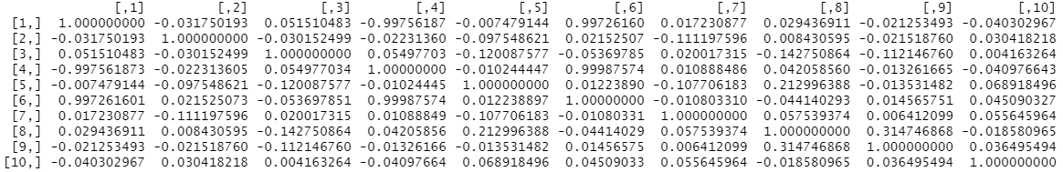
Diagnostic Checking
>install.packages("corpcor")
> library(corpcor)
> cor2pcor(cov(X))

Slide 14
Farrar – Glauber Test
The ‘mctest’ package in R provides the Farrar-Glauber test and other relevant tests for multicollinearity.
There are two functions viz. ‘omcdiag’ and ‘imcdiag’ under ‘mctest’ package in R which will provide the overall and individual diagnostic checking for multicollinearity respectively.

Slide 15
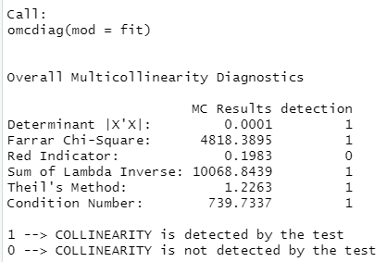
Farrar – Glauber Test
>install.packages("mctest")
> fit<- lm((WAGE)~OCCUPATION+SECTOR+UNION+EDUCATION+EXPERIENCE+AGE+SEX+MARR+RACE+SOUTH, data=wagesmicrodata)
> omcdiag(fit)

Slide 16
Farrar – Glauber Test
The value of the standardized determinant is found to be 0.0001 which is very small. The calculated value of the Chi-square test statistic is found to be 4818.3895 and it is highly significant thereby implying the presence of multicollinearity in the model specification.
This induces us to go for the next step of Farrar – Glauber test (F – test) for the location of the multicollinearity.
> imcdiag(fit)

Slide 17
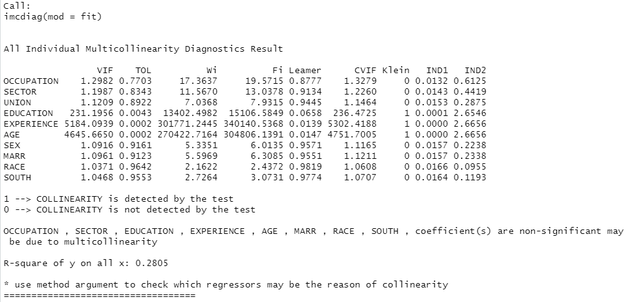

Slide 18
The VIF, TOL and Wi columns provide the diagnostic output for variance inflation factor, tolerance and Farrar-Glauber F-test respectively.
The F-statistic for the variable ‘experience’ is quite high (5184.0939) followed by the variable ‘age’ (F -value of 4645.6650) and ‘education’ (F-value of 231.1956). The degrees of freedom is (k−1,n−k)(k−1,n−k)or (9, 524).
For this degrees of freedom at 5% level of significance, the theoretical value of F is 1.89774. Thus, the F test shows that either the variable ‘experience’ or ‘age’ or ‘education’ will be the root cause of multicollinearity.
Though the F -value for ‘education’ is also significant, it may happen due to inclusion of highly collinear variables such as ‘age’ and ‘experience’.
Finally, for examining the pattern of multicollinearity, it is required to conduct t-test for correlation coefficient. As there are ten explanatory variables, there will be six pairs of partial correlation coefficients.
In R, there are several packages for getting the partial correlation coefficients along with the t- test for checking their significance level.
We’ll the ‘ppcor’ package to compute the partial correlation coefficients along with the t-statistic and corresponding p-values.

Slide 19
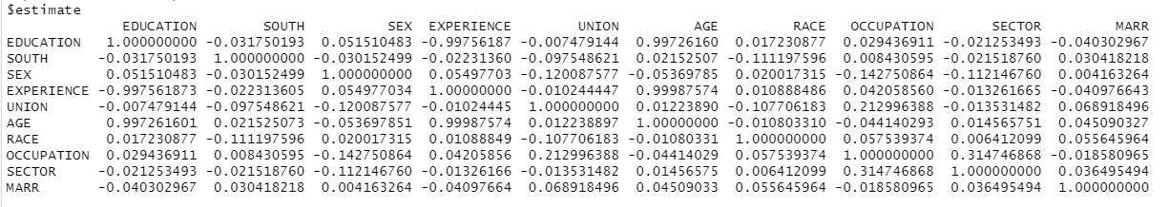
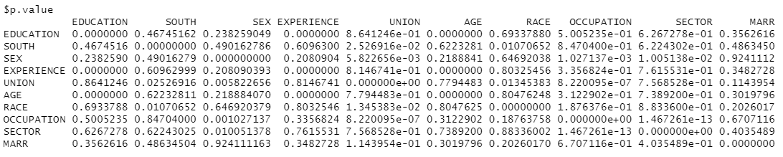
> install.packages("ppcor")
> library(ppcor)
> pcor(X, method = "pearson")

Slide 20
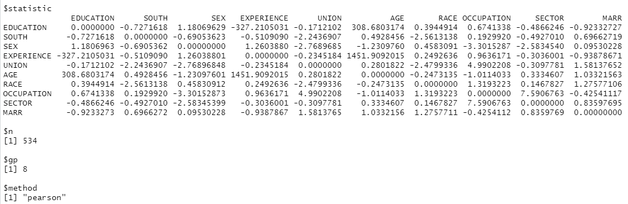
As expected the high partial correlation between ‘age’ and ‘experience’ is found to be highly statistically significant.
Similar is the case for ‘education – experience’ and ‘education – age’ .
Not only that even some of the low correlation coefficients are also found to be highyl significant. Thus, the Farrar-Glauber test points out that X1 is the root cause of all multicollinearity problem.

Slide 21
Remedial Measures
There are several remedial measure to deal with the problem of multicollinearity such Prinicipal Component Regression, Ridge Regression, Stepwise Regression etc.
However, in the present case, we’ll go for the exclusion of the variables for which the VIF values are above 10 and as well as the concerned variable logically seems to be redundant.
Age and experience will certainly be correlated.
So, why to use both of them?
If we use ‘age’ or ‘age-squared’, it will reflect the experience of the respondent also.
Thus, we try to build a model by excluding ‘experience’, estimate the model and go for further diagnosis for the presence of multicollinearity.

Slide 22
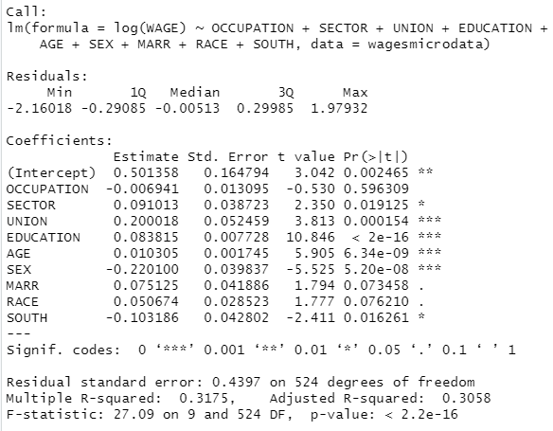
Remedial Measures
>fit2<- lm(log(WAGE)~OCCUPATION+SECTOR+UNION+EDUCATION+AGE+SEX+MARR+RACE+SOUTH, data=wagesmicrodata)
> summary(fit2)

Slide 23
Now by looking at the significance level, it is seen that out of nine of regression coefficients, eight are statistically significant. The R-square value is 0.31 and F-value is also very high and significant too.
Even the VIF values for the explanatory variables have reduced to very lower values.
> library(car)
> vif(fit2)
So, the model is now free from multicollinearity.

Slide 24
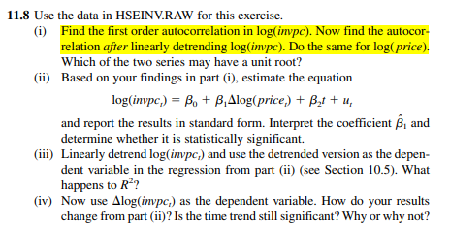
Autocorrelation

Slide 25
Autocorrelation
> library(wooldridge)
> data("hseinv")
> view(hseinv)
> reg<-lm(log(invpc)~log(price)+log(t), data=hseinv)
> summary(reg)

Slide 26
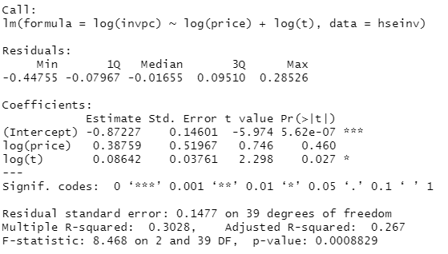
Autocorrelation

Slide 27
Visualizing Modeling Assumptions
> library(ggplot2)
> library(car)
> par(mfrow=c(2,2))
> plot(reg)

Slide 28
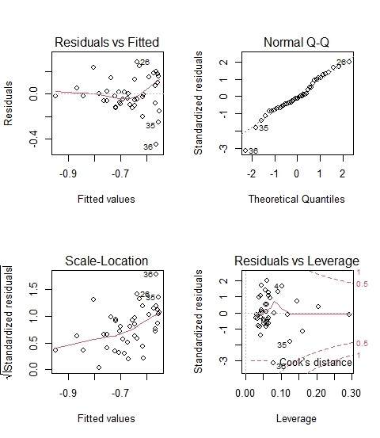
Visualizing Modeling Assumptions
The residuals vs fitted values graph shows points that do not appear to be randomly distributed across the x-axis.
This can be an indication of correlation in the error terms.
Further evidence of this for time series data can be seen when plotting the residuals in the order that they are created by the time series data.

Slide 29
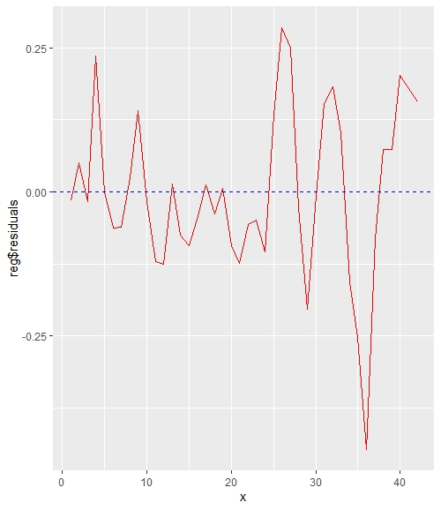
Visualizing Modeling Assumptions
> x = seq(1,length(reg$residuals))
> p = ggplot() + geom_line(data = hseinv, aes(x = x, y = reg$residuals), color = "red") + geom_hline(yintercept=0, linetype="dashed", color='blue')
> print(p)
In the above graph, points tend to be associated with the values of their neighbors to the left and right.
If the data were not autocorrelated, the values of the residuals would be randomly jump as we move from the left to the right.

Slide 30

Durbin Watson Test
> durbinWatsonTest(reg)

Slide 31
Fixing Autocorrelation by Adding Missing Predictors
One way to address autocorrelation errors, particularly in regards to time series data, is to include explanatory variables in the model.
The inclusion of these variable will help to remove the autocorrelation present in residuals.
> reg2<-lm(log(invpc)~log(price)+log(t)+linvpc_1, data=hseinv)
> summary(reg2)

Slide 32
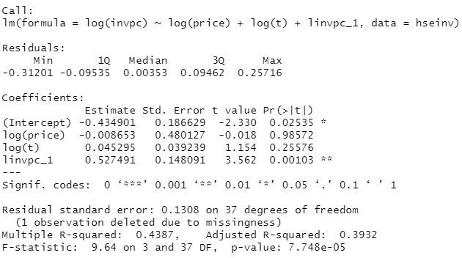

Fixing Autocorrelation by Adding Missing Predictors

